Slide 1
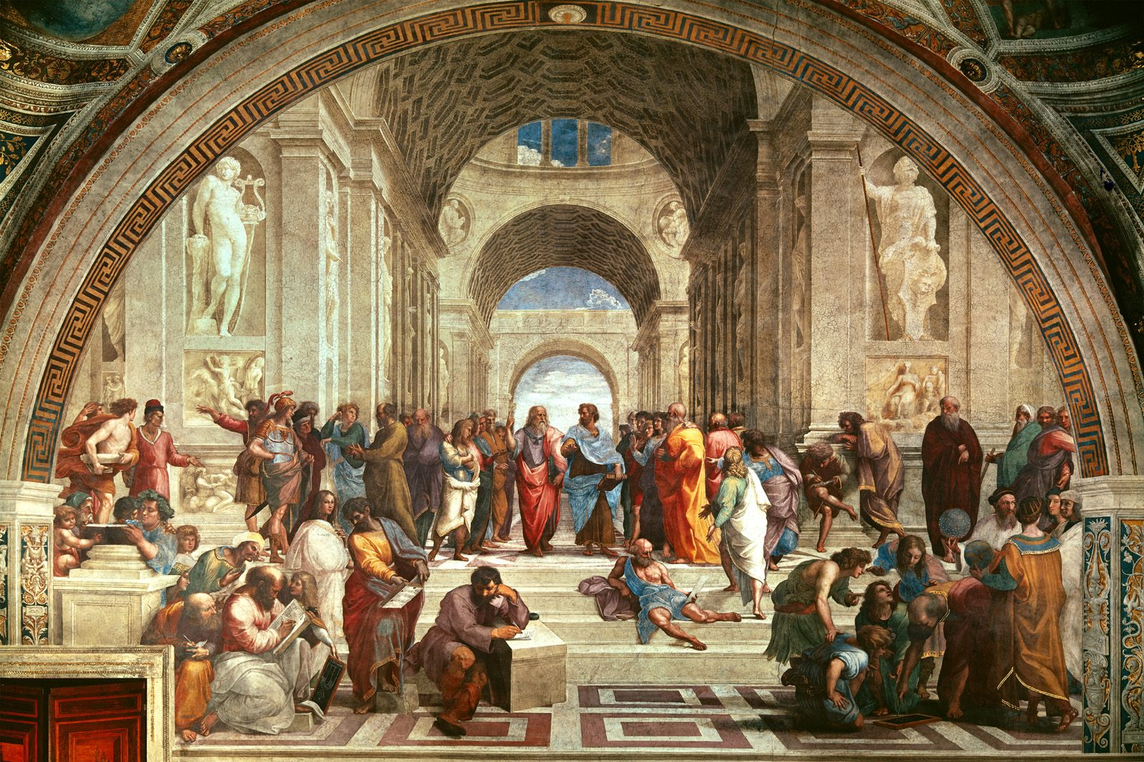
Classical Era (1750-1820)
Return to the Greek Classicism
Right and Wrong

Slide 2
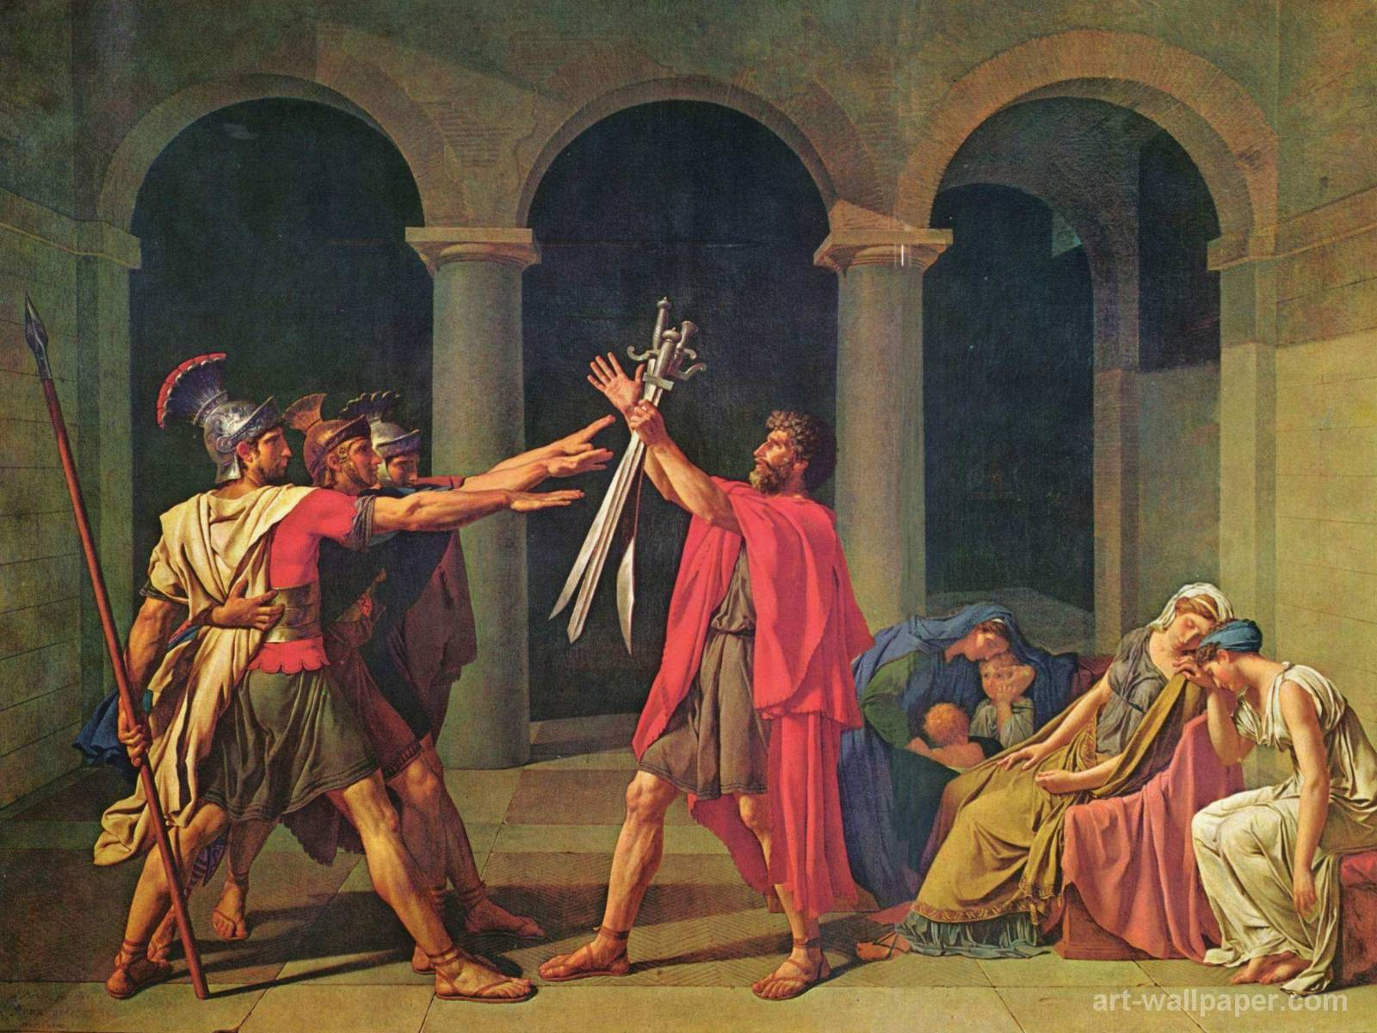

Slide 3
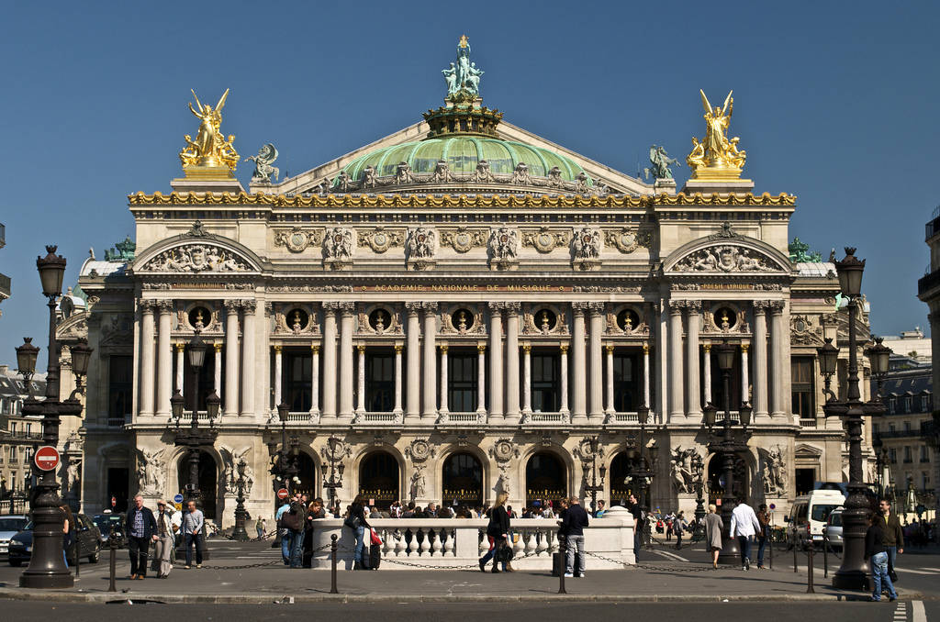
Architecture

Slide 4
Can you name this building?

Slide 5
WOLGANG AMADEUS MOZART
Born in Salzburg, Australia in 1756
At 5 he composed a set of Variations on Twinkle Twinkle
By age 8, he travelled through Europe
He had aural memory and wrote down a 9 voice choral at age 14.
He wore wig ,tights and high heel shoes
He composed Ein Kleine Nachtmusik
He had a good job and fame but dies poor
He had a virtuoso sister
He was a mathematician
He created opera (humor and drama)
He composed Requiem on his deathbed
His middle name means “Beloved by God”
He wrote 41 symphonies, one of them in a carriage ride.
He died at 35.

