Slide 1
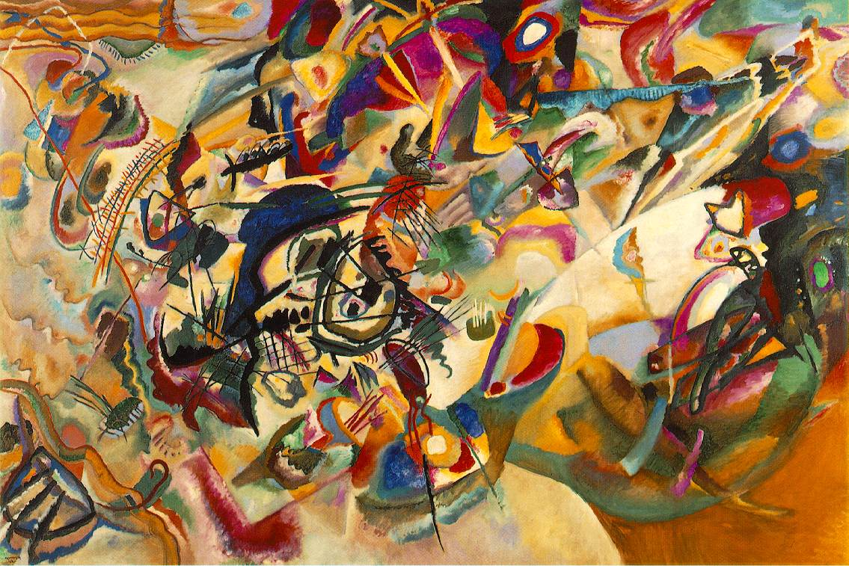
Music of Modern 20th Century

Slide 2
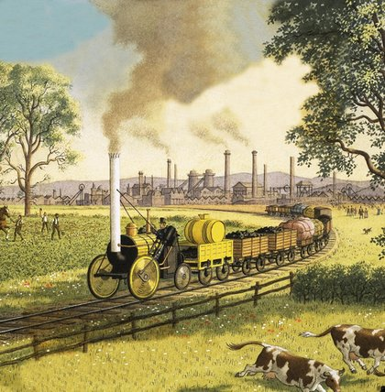
The happenings
Industrial Revolution
Rise of Factories and
Laborers
Growth of city
populations
Young people moving
For jobs and abandoning
their roots.

Slide 3
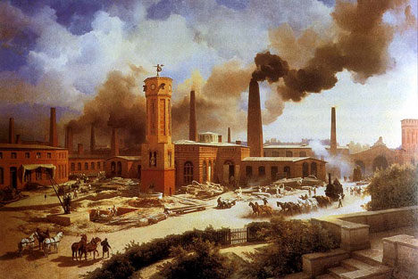

Slide 4
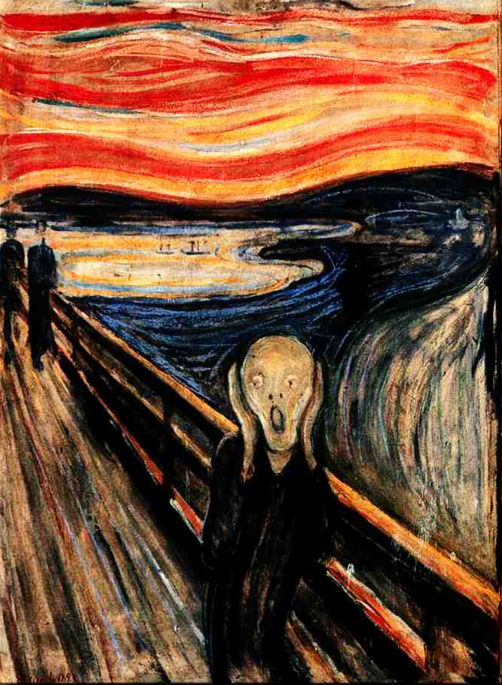
Where do people
get the models for
art and music?
Shock the senses?
What are the
standards?
?

Slide 5
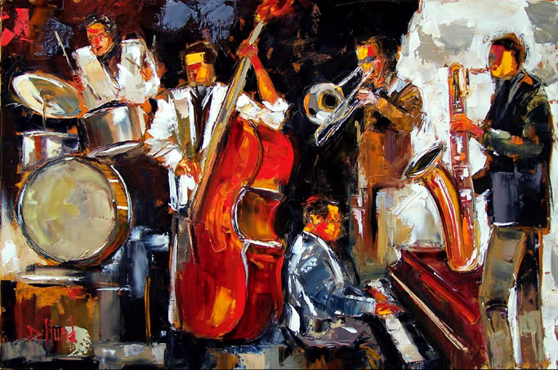
United States
Innovation of Jazz
Celebration of African-American culture

Slide 6
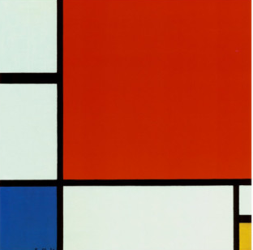
Germany - Atonality

