Slide 1
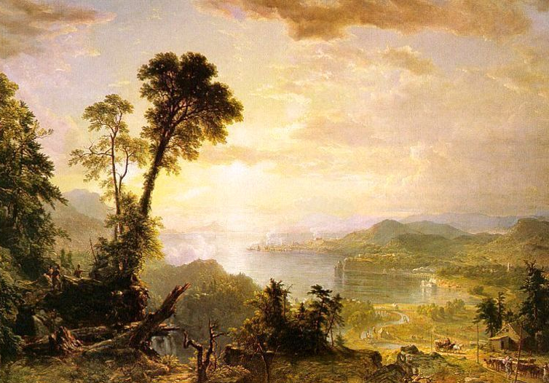
ROMANTIC ERA (1820-1900)

Slide 2
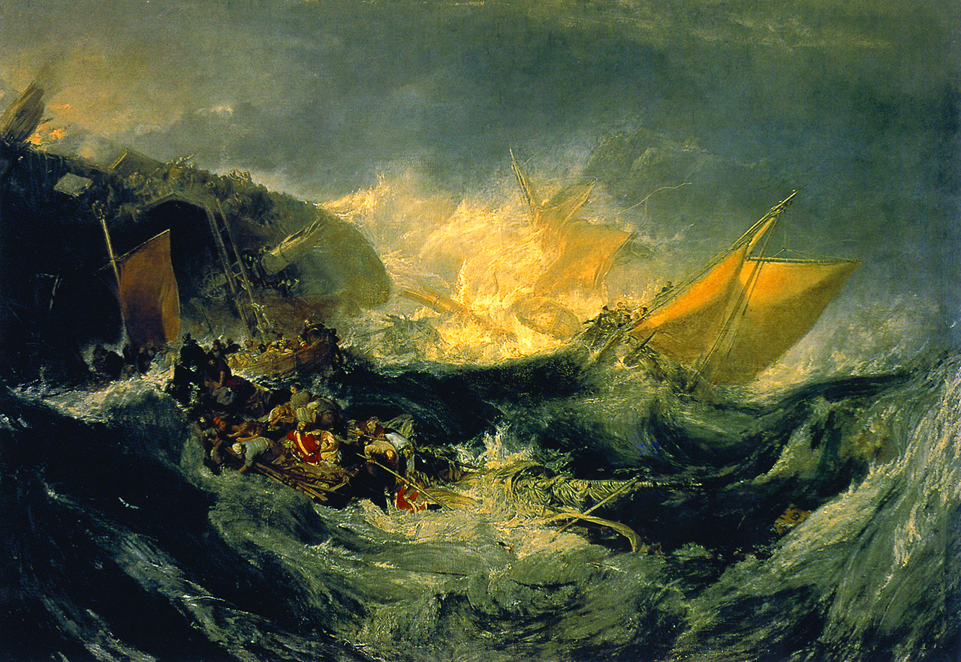

Slide 3
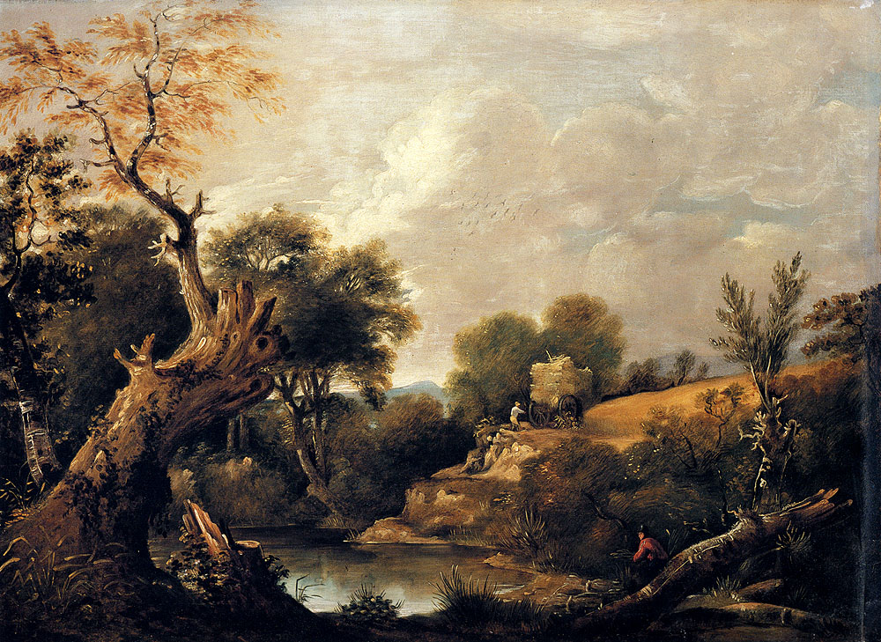

Slide 4
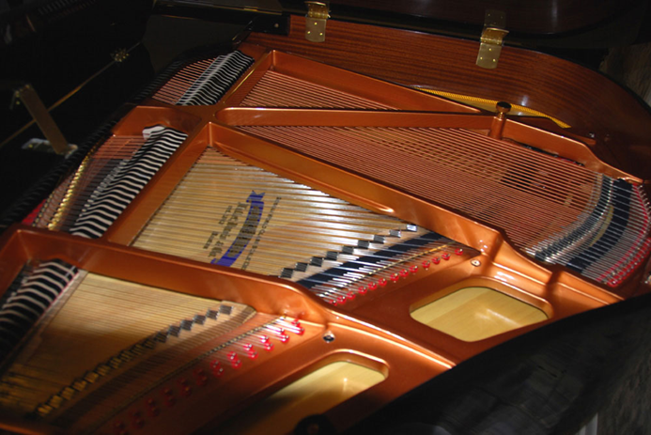
Greatest Piano Innovation in History
1820: Metal Soundboard:
Sustains Sound
Tuning pins
Supports thicker strings
Larger instruments

